Slide 1
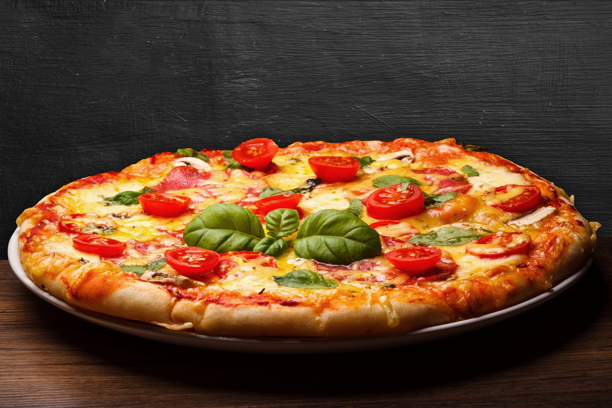

Domino’s
pizza orders & revenue analysis
tarjun sarkar
date: 26/10/2024

Slide 2
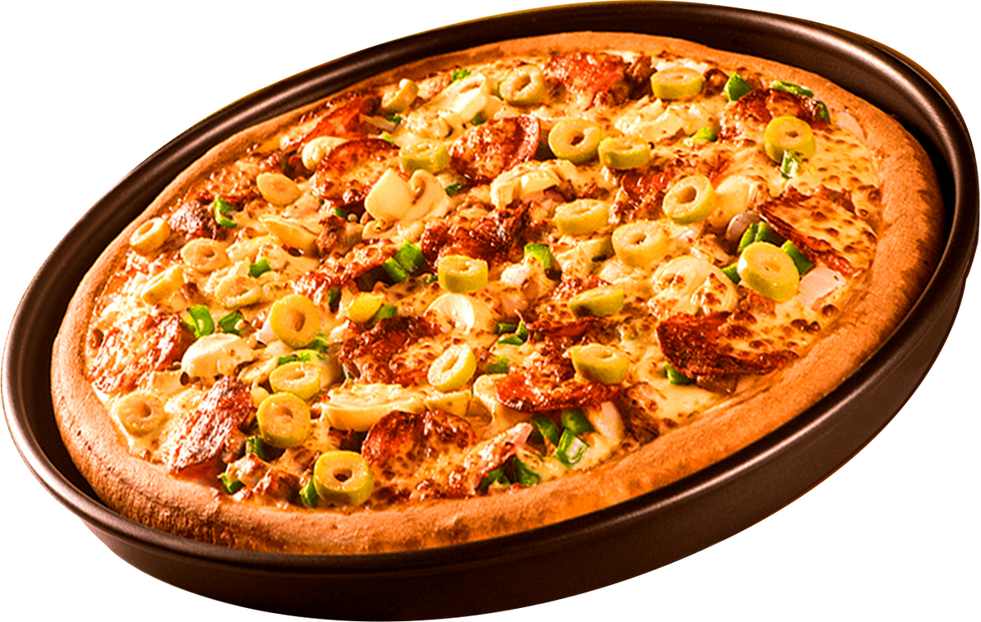




Domino’s
purpose of the analysis
This analysis of pizza sales data aims to provide a comprehensive overview of sales performance, highlighting top-selling pizza types, revenue contributions, and customer preferences. The objective is to empower stakeholders with actionable insights to inform strategic decisions, enhance product offerings, and drive business growth. We can optimize marketing efforts and improve customer satisfaction by leveraging data-driven findings.

Slide 3

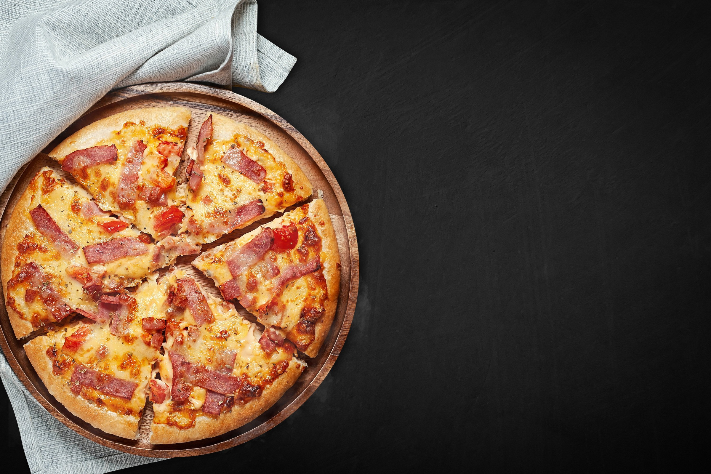

Domino’s
database & tables
The database for analyzing pizza sales is structured around four primary tables: pizzas, pizza_types, order _details, and orders. Each table serves a distinct purpose and is interconnected to facilitate comprehensive analysis.
pizzas
-----------
pizza_id
pizza_type_id
price
pizza_types
-------------
pizza_type_id
name
category
orders
------------
order_id
order_date
order_time
order_details
---------------
order_details_id
order_id
pizza_id
quantity

Slide 4
Domino’s
--rertive the total number of orders placed.
select
count(order_id) as total_orders
from
orders;
Total Orders
---------------
21350

Slide 5
Domino’s
-caleculate the total revenue generate from pizza sale-.
SELECT
ROUND(SUM(order_details.quantity * pizzas.price), 2) AS total_revenue
FROM
order_details
JOIN
pizzas ON pizzas.pizza_id = order_details.pizza_id;
total revenue
---------------
817860.05

Slide 6
Domino’s
-Top 5 Most Expensive Pizzas-
select
pizza_types.name, pizzas.price
from
pizza_types join pizzas
on pizzas.pizza_type_id = pizza_types.Pizza_type_id
order by pizzas.price desc limit 5;
pizza name | price
------------------------------------------------------------------
The greek pizza | 35.95
the greek pizza | 25.5
the brie carre pizza | 23.65
the Italian vegetable pizza | 21
the chicken pesto pizza | 20.75

Slide 7
Domino’s
-the most order pizza size-
select
pizzas.size, count (
order_details.order_details_id
)
as order_count
from
pizzas join order_details
on
pizzas.pizza_id = order_details.pizza_id
group by pizzas.size order by order_count desc;
pizza size | order count
---------------------------------
L | 18526
m | 15385
s | 14137
xl | 544
xxl | 28

Slide 8
Domino’s
-the 5 most order pizza types-
SELECT
pizza_types.name,
SUM(order_details.quantity) AS quantity_of_ordered_pizzas
FROM
pizza_types
JOIN
pizzas ON pizza_types.pizza_type_id = pizzas.pizza_type_id
JOIN
order_details ON order_details.pizza_id = pizzas.pizza_id
GROUP BY
pizza_types.name
ORDER BY
quantity_of_ordered_pizzas DESC
LIMIT 5;
pizza name | quantity of ordered pizza
-------------------------------------------------------------------------
The classic deluxe pizza | 2453
the barbecue chicken pizza | 2432
the hawaiian pizza | 2422
the pepperoni pizza | 2418
the thai chicken pizza | 2371

Slide 9
Domino’s
-total quantity of each pizza category ordered-
SELECT
pizza_types.category,
ROUND(SUM(order_details.quantity * pizzas.price),0) AS quantity
FROM
pizza_types
JOIN
pizzas ON pizza_types.pizza_type_id = pizzas.pizza_type_id
JOIN
order_details ON order_details.pizza_id = pizzas.pizza_id
GROUP BY
pizza_types.category
ORDER BY
quantity DESC;
CATEGORY | quantity
-------------------------
CLASSIC | 220053
SUPREME | 208197
CHICKEN | 195920
VAGGIE | 193690

Slide 10
Domino’s
-distribution of orders by hour of the day-
select extract (hour from order_time) as order_hour,
count(order_id) as order_count
from orders
group by order_hour order by order_hour asc;
order hour | order count
-------------------------
9:00 | 1
10:00 | 8
11:00 | 1231
12:00 | 2520
13:00 | 2455
14:00 | 1472
15:00 | 1468
16:00 | 1920
17:00 | 2336
18:00 | 2399
19:00 | 2009
20:00 | 1642
21:00 | 1198
22:00 | 663

Slide 11
Domino’s
-average number of pizzas ordered per day-
select round(avg(quantity),0) as avg_pizza_orders_per_day
from (
select orders.order_date, sum(order_details.quantity)as quantity
from orders join order_details
on orders.order_id = order_details.order_id
group by orders.order_date
)
as order_quantity;
avg pizzas ordered per day
-----------------------
138

Slide 12
Domino’s
-top 3 revenue generating pizzas-
SELECT
pizza_types.name,
SUM(order_details.quantity * pizzas.price) AS total_revenue
FROM
pizza_types
JOIN
pizzas ON pizza_types.pizza_type_id = pizzas.pizza_type_id
JOIN
order_details ON order_details.pizza_id = pizzas.pizza_id
GROUP BY
pizza_types.name
ORDER BY
total_revenue DESC
LIMIT
3;
pizza naem | total revenue
---------------------------------------------------
the thai chicken pizza | 220053
the barbecue chicken pizza | 208197
the california pizza | 195920

Slide 13
Domino’s
-Pizza Category Contribution to Revenue-
SELECT
pizza_types.category,
ROUND(
SUM(order_details.quantity * pizzas.price) /
(
SELECT
ROUND(SUM(order_details.quantity * pizzas.price), 2) AS total_revenue
FROM
order_details
JOIN
pizzas ON pizzas.pizza_id = order_details.pizza_id
) * 100,
2
) AS revenue
FROM
pizza_types
JOIN
pizzas ON pizza_types.pizza_type_id = pizzas.pizza_type_id
JOIN
order_details ON order_details.pizza_id = pizzas.pizza_id
GROUP BY
pizza_types.category;
category | percentage contribution
------------------------------------------
supreme | 25.46
chicken | 23.96
classic | 26.91
veggie | 23.68

Slide 14
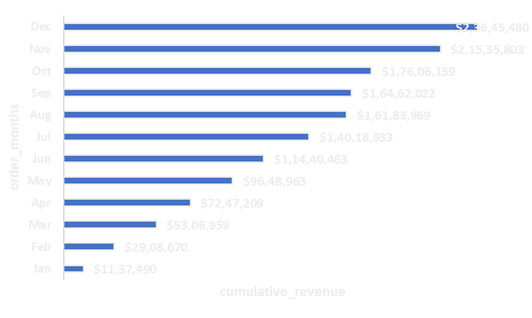
Domino’s
_cumulative revenue generate over time_
SELECT
order_date,
SUM(revenue) OVER (ORDER BY order_date) AS cumulative_revenue
FROM (
SELECT
orders.order_date,
SUM(order_details.quantity * pizzas.price) AS revenue
FROM
order_details
JOIN
pizzas ON order_details.pizza_id = pizzas.pizza_id
JOIN
orders ON orders.order_id = order_details.order_id
GROUP BY
orders.order_date
) AS total_sales;

Slide 15
Domino’s
top 3 most ordered pizza types based on revenue for each pizza category
SELECT name, total_revenue
FROM (
SELECT
category,
name,
total_revenue,
RANK() OVER (PARTITION BY category ORDER BY total_revenue DESC) AS rank
FROM (
SELECT
pizza_types.category,
pizza_types.name,
SUM(order_details.quantity * pizzas.price) AS total_revenue
FROM
pizza_types
JOIN
pizzas ON pizza_types.pizza_type_id = pizzas.pizza_type_id
JOIN
order_details ON order_details.pizza_id = pizzas.pizza_id
GROUP BY
pizza_types.category, pizza_types.name
) AS revenue_for_each_pizza_category
) AS A
WHERE rank <= 3;
pizza name | total revenue
-------------------------------------
the thai chicken pizza | 43434.25
the barbecue chicken pizza | 42768.00
the california chicken pizza | 41409.50
the classic deluxe pizza | 38180.5
the hawaiian pizza | 32273.25
the pepperoni pizza | 30161.75
the spicy Italian pizza | 34831.25

Slide 16
Domino’s
thank you!

